Slide 1
Scientific Theory in Informatics A1N
Probability & Discrete Event Simulation
Richard Senington
Based on slides by David Vernon
University of Skövde
Richard.james.senington@his.se

Slide 2
Overview
Background, History and Definitions of Probability
Discrete probability
Bayesian inference
Continuous probability
Discrete Event Simulation

Slide 3
Background

Slide 4
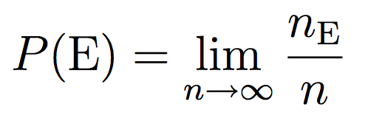
1. A brief background
Three major interpretations of probability
Frequentist: probability as a relative frequency
Probability of an event as the proportion of times such an event is expected to happen in the long run.
The probability of an event E would be the limit of the relative frequency of occurrence of that event as the number of observations grows large
Number of times the event is observed
Number of independent experiments

Slide 5
1. A brief background
Three major interpretations of probability
Frequentist: probability as a relative frequency
Rolling Dice, how many 6s
Number of tests | Dice 1 (6s) | Dice2 (6s) | P(D1==6) | P(D2==6)
50 | 5 | 10 | 0.1 | 0.2
100 | 19 | 24 | 0.19 | 0.24
150 | 27 | 37 | 0.18 | 0.246667
200 | 36 | 54 | 0.18 | 0.27
250 | 46 | 72 | 0.184 | 0.288
300 | 54 | 93 | 0.18 | 0.31
350 | 59 | 109 | 0.168571 | 0.311429
400 | 65 | 128 | 0.1625 | 0.32
450 | 73 | 150 | 0.162222 | 0.333333
500 | 82 | 164 | 0.164 | 0.328
1000 | 161 | 327 | 0.161 | 0.327
1500 | 244 | 480 | 0.162667 | 0.32
2000 | 328 | 644 | 0.164 | 0.322
2500 | 420 | 795 | 0.168 | 0.318
3000 | 509 | 943 | 0.169667 | 0.314333
3500 | 595 | 1087 | 0.17 | 0.310571
4000 | 678 | 1242 | 0.1695 | 0.3105
4500 | 762 | 1382 | 0.169333 | 0.307111
5000 | 865 | 1542 | 0.173 | 0.3084
D1, fair (1/6)
D2 unfair (3/10)

Slide 6
1. A brief background
Three major interpretations of probability
Frequentist: probability as a relative frequency
Appealing: objective, ties in with work on observation of physical events
Can’t perform an experiment an infinite number of times
Behaviourist approach: based on observable behaviour of physical systems
Doesn’t capture idea of probability as internal knowledge of cognitive systems

Slide 7
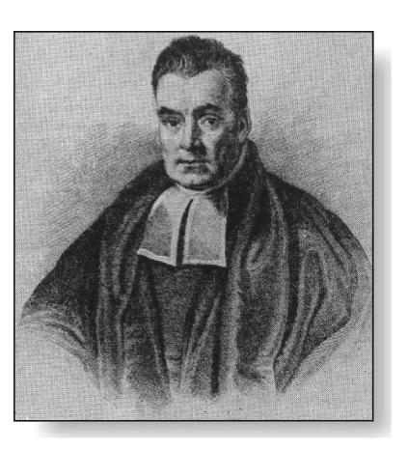

1. A brief background
Three major interpretations of probability
Bayesian or subjectivist: probability as uncertain knowledge or “reasonable expectation”
Useful in the field of machine intelligence
Where you need to have knowledge systems capable of handling the uncertainty of the world
Probabilists that are willing to represent internal knowledge using probability theory are called “Bayesian” (since he was the first mathematician to do so)

Slide 8
1. A brief background
Three major interpretations of probability
Axiomatic or mathematical: probability as a mathematical model
Rigorous definition
Traceable to first principles
Avoid the frequentist vs. Bayesian debate
Application of probability theory is not the main concern

Slide 9
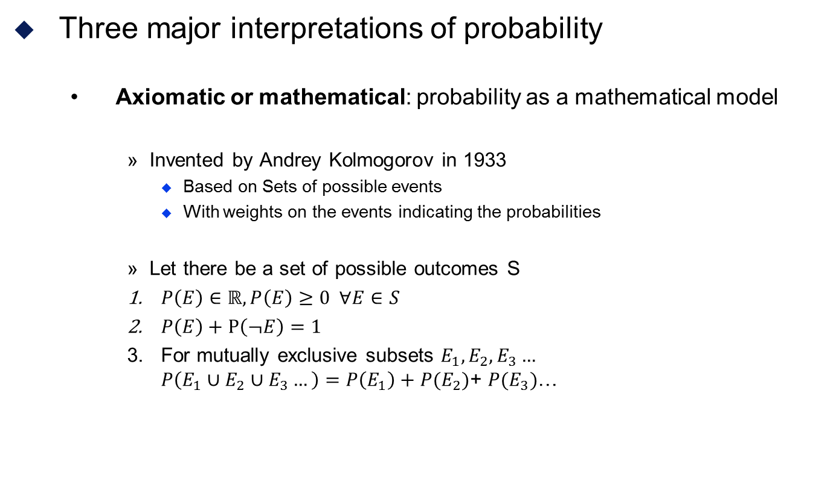
1. A brief background
Three major interpretations of probability
Axiomatic or mathematical: probability as a mathematical model
Invented by Andrey Kolmogorov in 1933
Based on Sets of possible events
With weights on the events indicating the probabilities
Let there be a set of possible outcomes S
$P\left(E\right)∈\text{ℝ}, P\left(E\right)≥0 ∀E∈S$
$P\left(E\right)+P\left(¬E\right)=1$
For mutually exclusive subsets $E_{1},E_{2},E_{3}…$ $P\left(E_{1}∪E_{2}∪E_{3}…\right)=P\left(E_{1}\right)+P(E_{2})$+ $P(E_{3})$…

Slide 10
1. A brief background
Probability Theory provides a mathematical foundation for many concepts
Information
Belief
Uncertainty
Confidence
Randomness
Variability
Chance
Risk

Slide 11
1. A brief background
Probability Theory provides
A framework for making inferences and testing hypotheses based on uncertain empirical data
Building systems that operate in an uncertain world
Machine perception (speech recognition, computer vision)
Artificial intelligence
Theoretical framework for understanding how the brain works
Many computational neuroscientists think the brain is a probabilistic computer build with unreliable components (i.e. neurons)

Slide 12
1. A brief background
Probability Theory provides
A way of determining the average-case complexity of algorithms
A way of determining whether we should reject an incoming email message as spam based on the words that appear in the message
(http://www.youtube.com/watch?v=M_eYSuPKP3Y)
A way of combining different sources of uncertain information to make rational decisions

Slide 13
Discrete Probability

Slide 14
2. Discrete Probability
The modern definition is based upon set theory
There is a set of possible outcomes S
E.g. S={A,B,C}
Also called a reference set
An event is a subset of an outcome set
E.g. E₁={A} E₂={A,B}
There is a function that defines the liklihood of any event
E.g. p :: E->Float p({A}) = 0.3 p({B}) = 0.4 p({C}) = 0.3
This is a Probability Mass Function
The total of a PMF must be 1.0
The size of the set of possible outcomes must be finite or countable

Slide 15

2. Discrete Probability
Computing Probabilities
From known sets
For an event E, and a sample space S
The probability of an event is the size of the event set divided by the total size of the sample space
$p\left(E\right)=\frac{\left|E\right|}{|S|}$

Slide 16
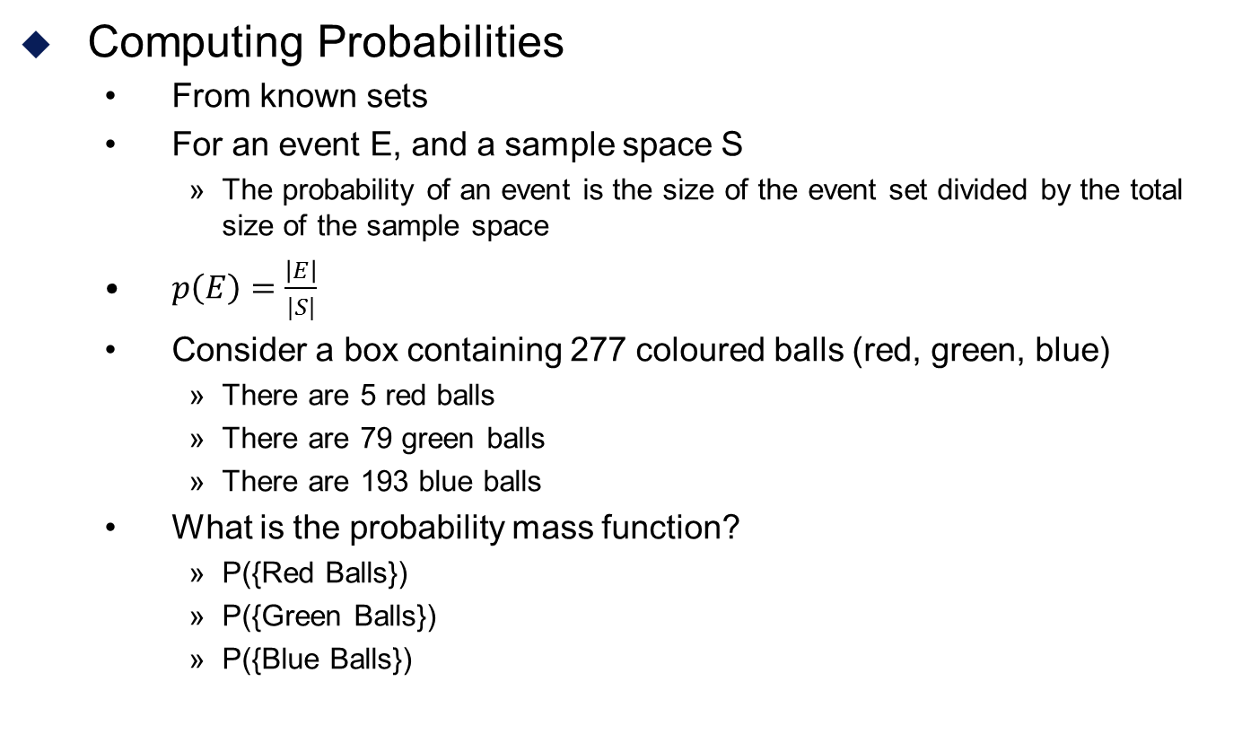
2. Discrete Probability
Computing Probabilities
From known sets
For an event E, and a sample space S
The probability of an event is the size of the event set divided by the total size of the sample space
$p\left(E\right)=\frac{\left|E\right|}{|S|}$
Consider a box containing 277 coloured balls (red, green, blue)
There are 5 red balls
There are 79 green balls
There are 193 blue balls
What is the probability mass function?
P({Red Balls})
P({Green Balls})
P({Blue Balls})

Slide 17
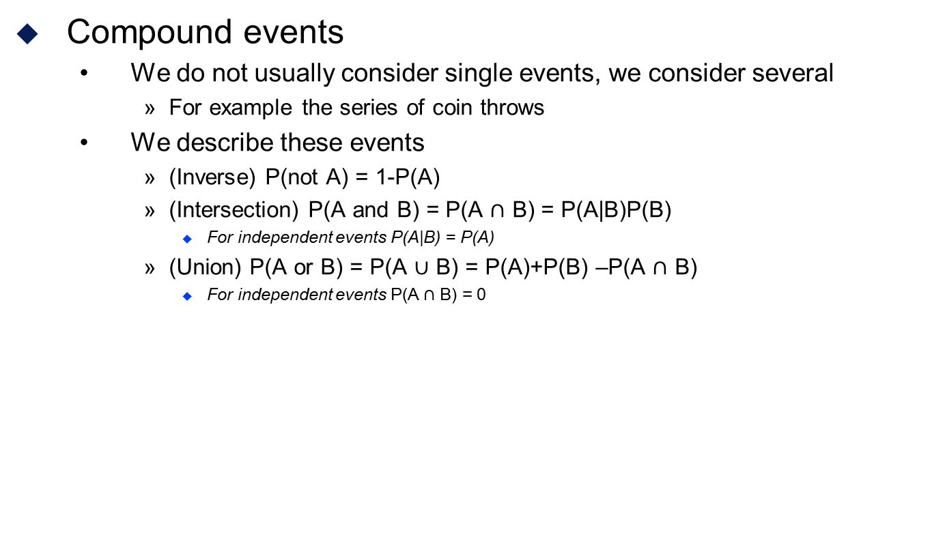
2. Discrete Probability
Compound events
We do not usually consider single events, we consider several
For example the series of coin throws
We describe these events
(Inverse) P(not A) = 1-P(A)
(Intersection) P(A and B) = P(A $∩$ B) = P(A|B)P(B)
For independent events P(A|B) = P(A)
(Union) P(A or B) = P(A $∪$ B) = P(A)+P(B) –P(A $∩$ B)
For independent events P(A $∩$ B) = 0

Slide 18
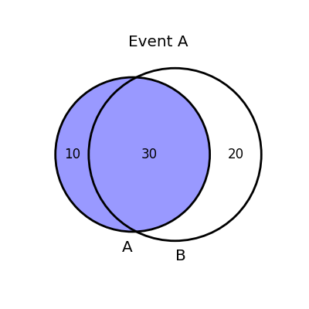
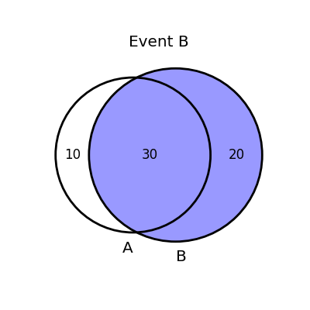
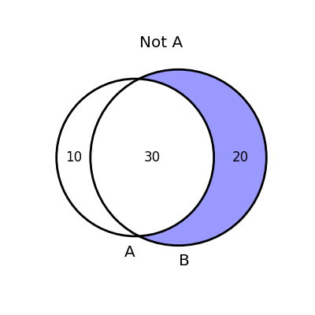

2. Discrete Probability
Compound events
We do not usually consider single events, we consider several
For example a series of coin throws
From a basic probability function we can infer additional properties
(Inverse) P(not A) = 1-P(A)
(Intersection) P(A and B) = P(A $∩$ B) = P(A|B)P(B)
For independent events P(A|B) = P(A)
(Union) P(A or B) = P(A $∪$ B) = P(A)+P(B) –P(A $∩$ B)
For independent events P(A $∩$ B) = 0

Slide 19
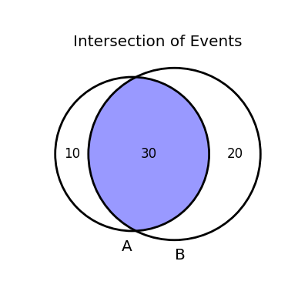
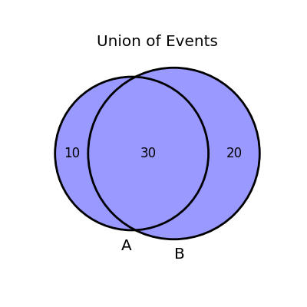
2. Discrete Probability
Compound events
We do not usually consider single events, we consider several
For example a series of coin throws
From a basic probability function we can infer additional properties
(Inverse) P(not A) = 1-P(A)
(Intersection) P(A and B) = P(A $∩$ B) = P(A|B)P(B)
For independent events P(A|B) = P(A)
(Union) P(A or B) = P(A $∪$ B) = P(A)+P(B) –P(A $∩$ B)
For independent events P(A $∩$ B) = 0

Slide 20
2. Discrete Probability
Compound events/Joint Probability
For example we will take a biased coin
P(Tails) = 0.3
P(Heads) = 0.7
It will be flipped twice giving S={HH,HT,TH,TT}
P(TT) = P(T and T) = 0.3*0.3 = 0.09
P(not TT) = 1-0.09 = 0.91
P(TH or HH) = P(T and H)+P(H and H) = 0.3*0.7 + 0.7*0.7 = 0.7

Slide 21
Discrete Probability
Bayesian inference

Slide 22
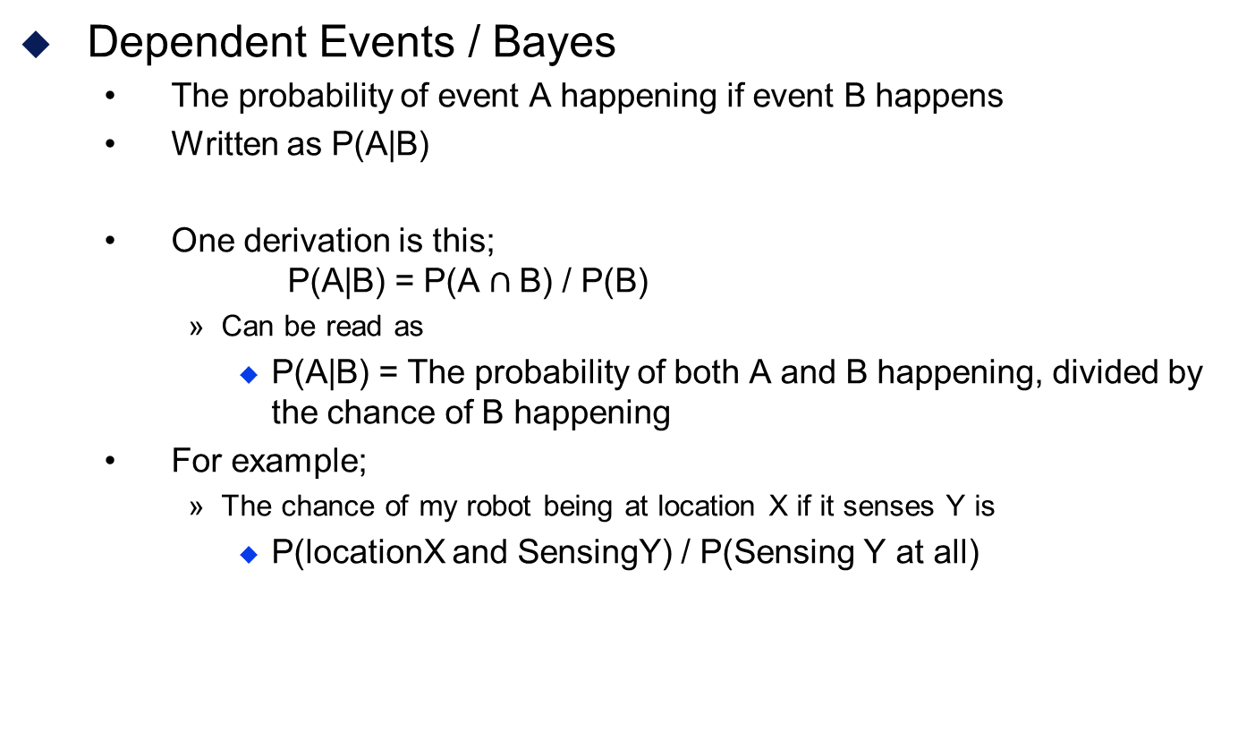
2. Discrete Probability
Dependent Events / Bayes
The probability of event A happening if event B happens
Written as P(A|B)
One derivation is this; P(A|B) = P(A $∩$B) / P(B)
Can be read as
P(A|B) = The probability of both A and B happening, divided by the chance of B happening
For example;
The chance of my robot being at location X if it senses Y is
P(locationX and SensingY) / P(Sensing Y at all)
Probability of A given B
Chance of A being true subject to the chance of B being true

Slide 23
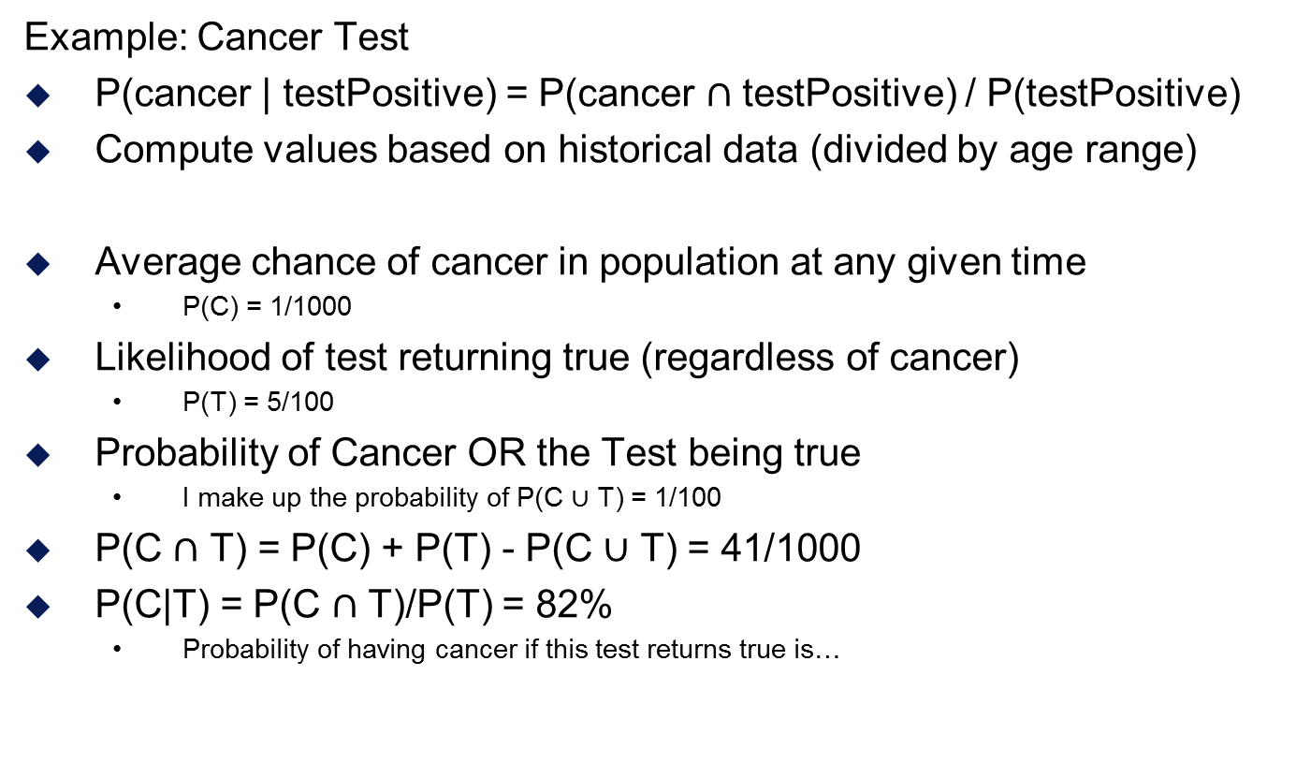
2. Discrete Probability
Example: Cancer Test
P(cancer | testPositive) = P(cancer $∩$ testPositive) / P(testPositive)
Compute values based on historical data (divided by age range)
Average chance of cancer in population at any given time
P(C) = 1/1000
Likelihood of test returning true (regardless of cancer)
P(T) = 5/100
Probability of Cancer OR the Test being true
I make up the probability of P(C $∪$ T) = 1/100
P(C $∩$ T) = P(C) + P(T) - P(C $∪$ T) = 41/1000
P(C|T) = P(C $∩$ T)/P(T) = 82%
Probability of having cancer if this test returns true is…

Slide 24

2. Discrete Probability
Example: Cancer Test
P(cancer | testPositive) = P(cancer $∩$ testPositive) / P(testPositive)
Compute values based on historical data (divided by age range)
 | Cancer | No Cancer
Test Positive | P(Cancer | TestPos) | P(-Cancer|TestPos)
Test Negative | P(Cancer | TestNeg) | P(-Cancer|TestNeg)
 | Cancer | No Cancer
Test Positive |  | False Positive
Test Negative | False Negative

Slide 25
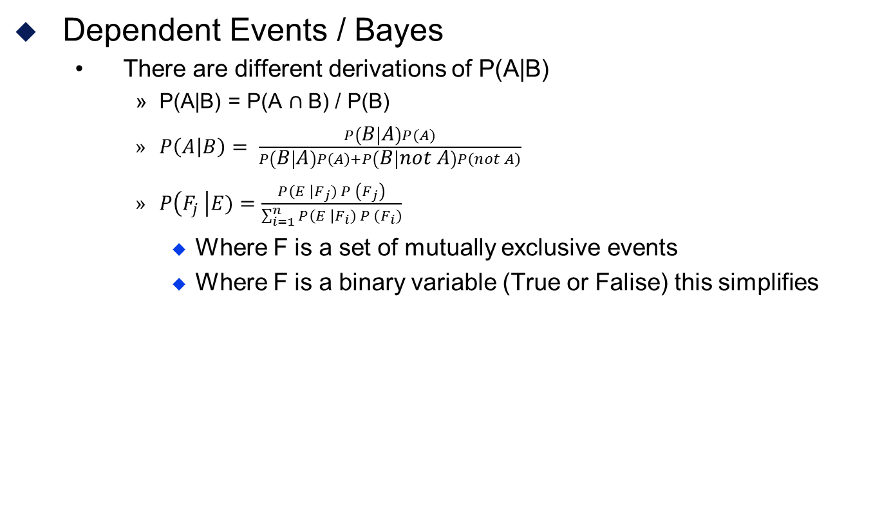
2. Discrete Probability
Dependent Events / Bayes
There are different derivations of P(A|B)
P(A|B) = P(A $∩$B) / P(B)
$P\left(A | B\right)= \frac{P\left(B | A\right)P(A)}{P\left(B | A\right)P\left(A\right)+P\left(B | not A\right)P\left(not A\right)}$
$P\left(F_{j }\right|E)=\frac{P\left(E \right|F_{j}) P \left(F_{j}\right)}{\sum_{i=1}^{n}{P\left(E \right|F_{i}) P (F_{i})}}$
Where F is a set of mutually exclusive events
Where F is a binary variable (True or Falise) this simplifies
Notes:
Notes for self.
P(pattern) = probability of the set of outputs wwr
P(BagB | pattern) = P(BagB AND pattern) / P(pattern)
P(pattern) = P(pattern AND BagB) + P(pattern AND BagA)
P(BagB and Pattern) = 0.5 * (wwr,wrw,rww)->0.5*(4/7*3/6*3/5 + 4/7*3/6*3/5 + 3/7*4/6*3/5) = ½ * 3 * (36/210) = 54/210
P(BagA and Pattern) = 0.5 * (3/7*2/6*4/5 + 3/7*4/6*2/5 + 4/7*3/6*2/5) = 6/35 36/210
P(Pattern) = (36+54)/210 = 90/210 = 3/7
P(BagB | Pattern) = 54*21/210*9 = 3/5

Slide 26
2. Discrete Probability
Shows how to revise probability of events in the light of new data
For example we can determine the probability that a particular incoming email is spam using the occurrence of words in the message
To do this it is helpful to know
The percentage of incoming emails that are spam
The percentage of spam messages in which these words occur
The percentage of messages that are not spam in which each of these words occur

Slide 27
2. Discrete Probability
Example: Naive Bayesian Spam Filter
Let p(SPAM) be the prior probability that a message is spam
Let p(not SPAM) be the prior probability that a message is valid
We can base this on historical data or, assuming maximum ignorance, assume the are both equally likely in which case
p(SPAM) = p(not SPAM) = 50%

Slide 28
2. Discrete Probability
Example: Bayesian Spam Filter
Suppose we have a set of B of messages known to be spam
Suppose we have a set of G of valid messages known not to be spam
P(SPAM) = B/(B+G)
Count the number of messages in B containing the test word w: n_{B}(w) The (empirical) probability that a spam message contains word w is p(w | SPAM) = n_{B}(w) / |B|
Count the number of messages in G containing the word w: n_{G}(w)
The (empirical) probability that a valid message contains word w is
p(w | not SPAM) = n_{B}(w) / |G|
be an event from a sample space S
F₁, F₂, … F_{n}, are mutually exclusive events such that
F₁ ∪ F₂, … ∪ F_{n} = S
p(E) ≠ 0 and p(F_{i}) ≠ 0

Slide 29
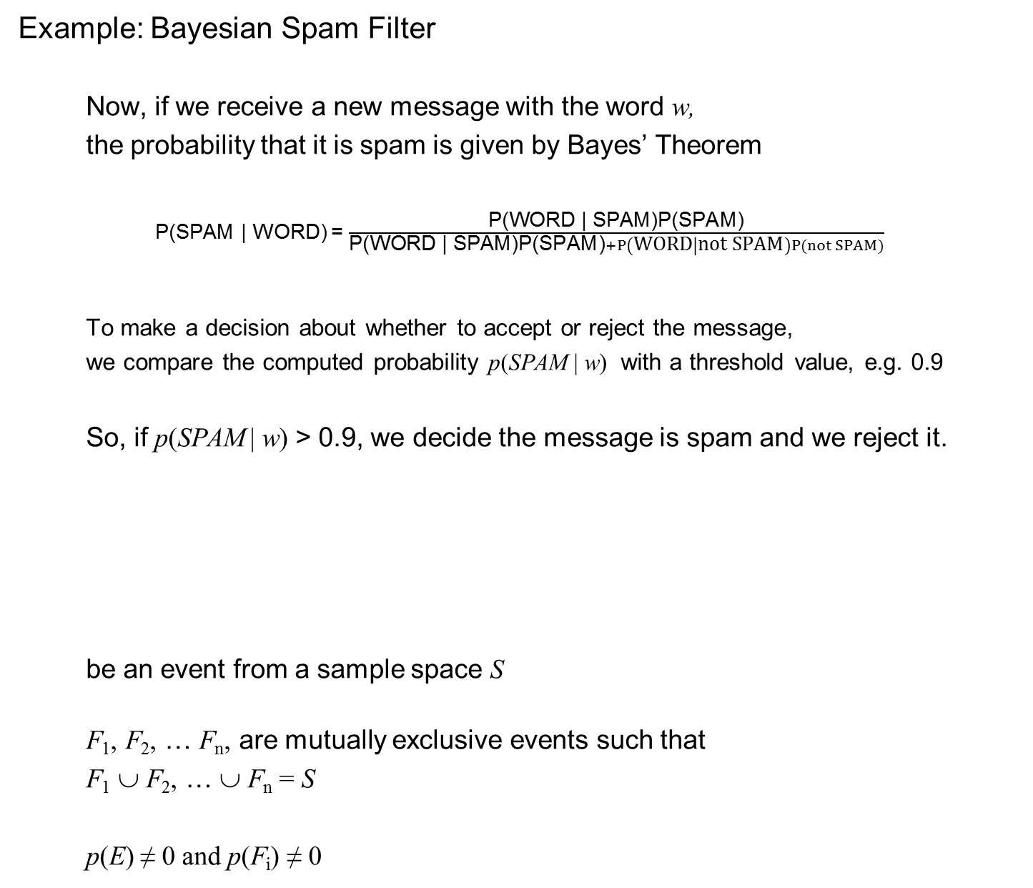
2. Discrete Probability
Example: Bayesian Spam Filter
Now, if we receive a new message with the word w,
the probability that it is spam is given by Bayes’ Theorem
P(SPAM | WORD) = $\frac{\text{P}\text{(}\text{WORD}\text{ | }\text{SPAM}\text{)}\text{P}\text{(}\text{SPAM}\text{)}}{\text{P}\text{(}\text{WORD}\text{ |} \text{SPAM}\text{)}\text{P}\text{(}\text{SPAM}\text{)}+P\left(WORD | not SPAM\right)P(not SPAM)}$
To make a decision about whether to accept or reject the message,
we compare the computed probability p(SPAM | w) with a threshold value, e.g. 0.9
So, if p(SPAM | w) > 0.9, we decide the message is spam and we reject it.
be an event from a sample space S
F₁, F₂, … F_{n}, are mutually exclusive events such that
F₁ ∪ F₂, … ∪ F_{n} = S
p(E) ≠ 0 and p(F_{i}) ≠ 0

Slide 30
Continuous Probability

Slide 31
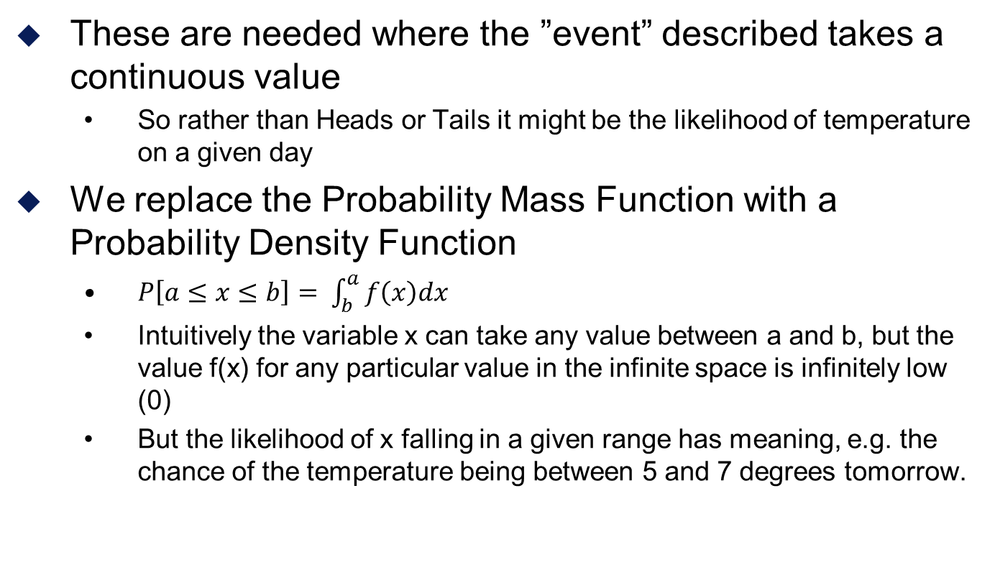
3. Continuous Probability
These are needed where the ”event” described takes a continuous value
So rather than Heads or Tails it might be the likelihood of temperature on a given day
We replace the Probability Mass Function with a Probability Density Function
$P\left[a≤x≤b\right]= \int_{b}^{a}{f\left(x\right)dx}$
Intuitively the variable x can take any value between a and b, but the value f(x) for any particular value in the infinite space is infinitely low (0)
But the likelihood of x falling in a given range has meaning, e.g. the chance of the temperature being between 5 and 7 degrees tomorrow.

Slide 32
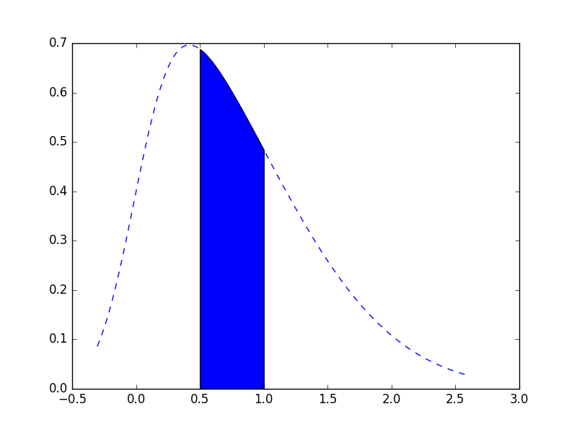
3. Continuous Probability
The the probability between two values is the area under the curve of the PDF

Slide 33
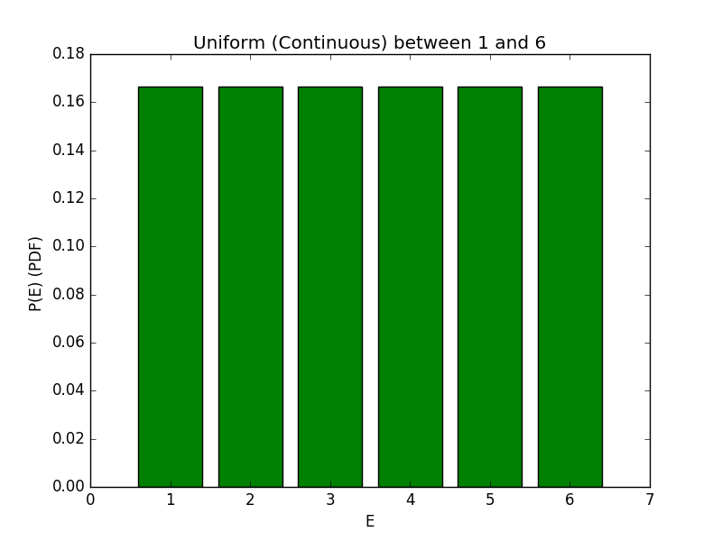
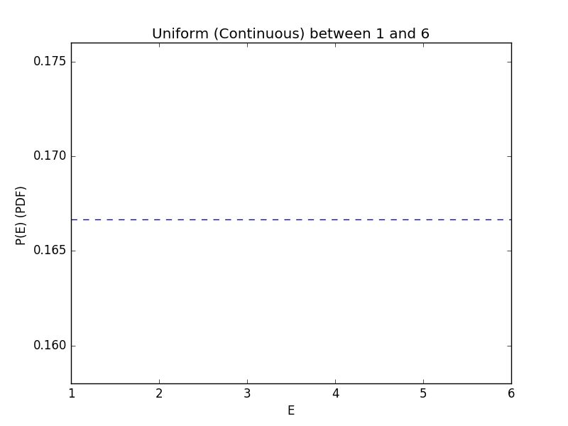
4. Probability Distributions
The Uniform Distribution
Where every outcome is equally likely
Can be discrete or continuous
Think dice (for discrete example)

Slide 34
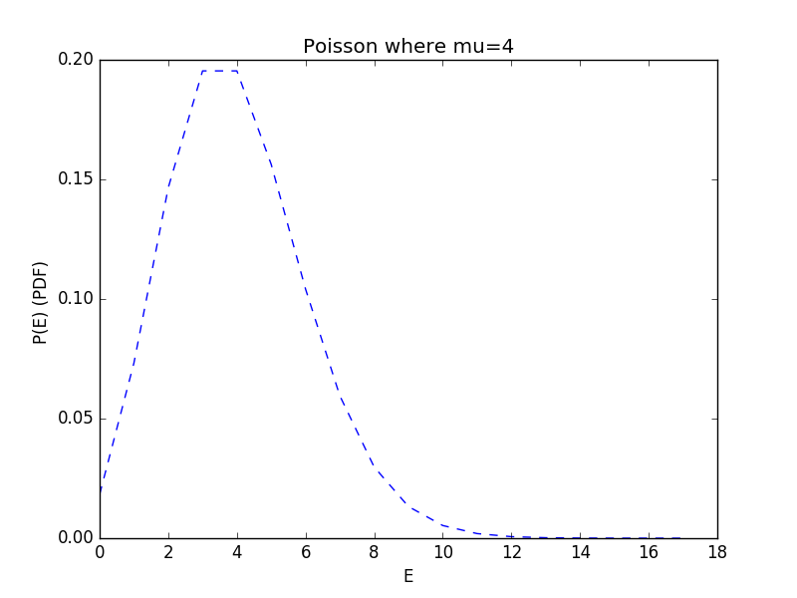
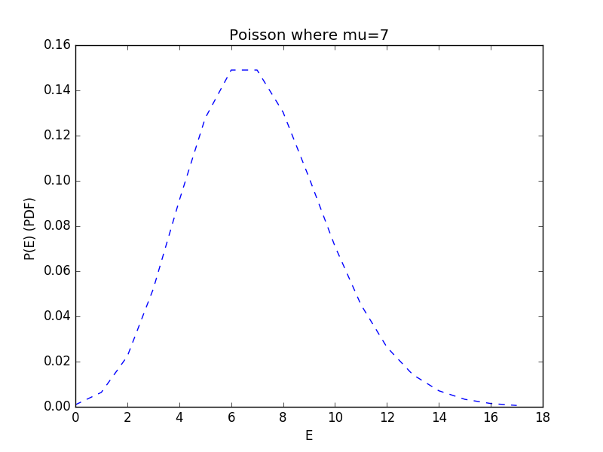
4. Probability Distributions
The Poisson Distribution
number of events in a fixed interval of time and/or space where events occure at an average rate
Number of customers in X minutes given known average of …

Slide 35
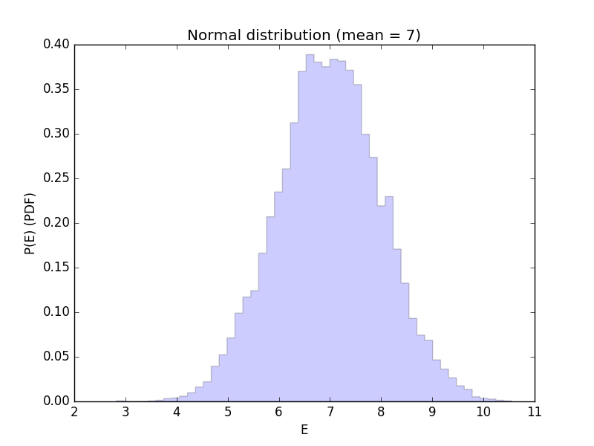
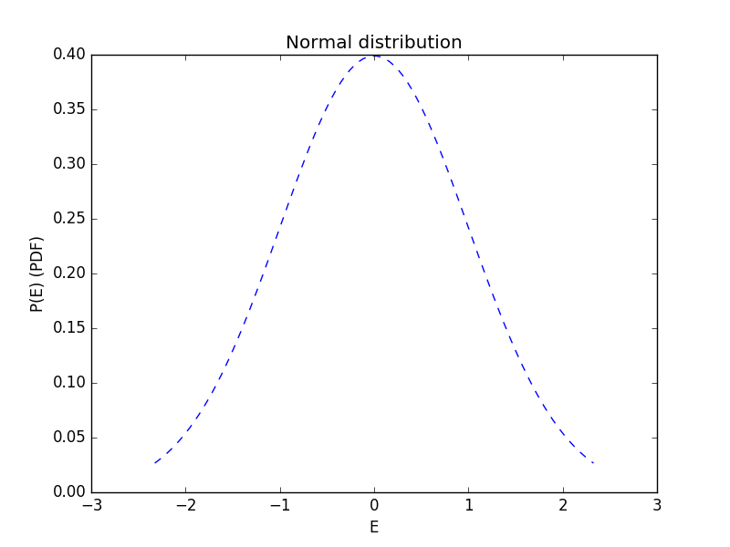
4. Probability Distributions
The Normal Distribution
Expected variation in values around an average
For example
The variation in values from repeated experiments

Slide 36
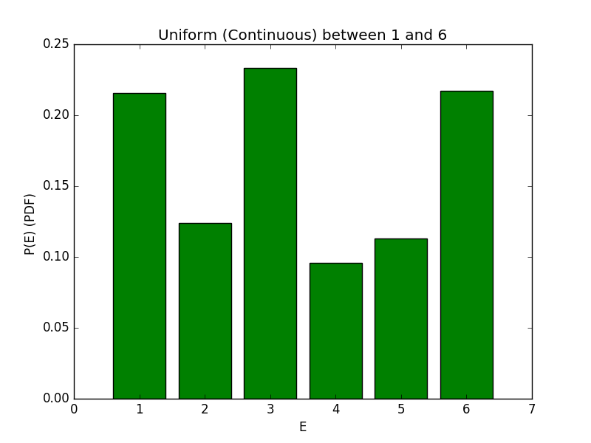
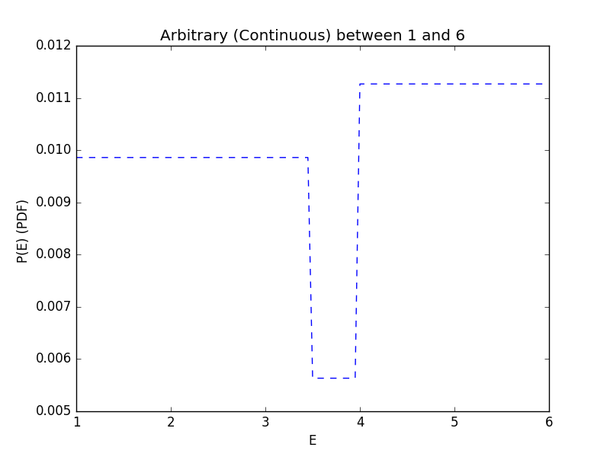
4. Probability Distributions
Arbitrary Distribution
The probability function is defined by us, or observation of the environment
E.g. the casino is cheating with loaded dice

Slide 37
Discrete Event Simulation

Slide 38
5. Discrete Event Simulation
Experimenting with the real world to understand it can be expencive
How will a drug work on a human body?
How will a change impact a factory (or an engine)?
Where should we build the next hospital?
One approach is to build a model within a computer and play with that
Simulation is ”the imitation of the operation of a real-world process or system over time” (Banks, Carson,Nelson,Nicol)
(or a fantasy world for game programmers)

Slide 39
5. Discrete Event Simulation
Discrete Event Simulation, a simulation which changes in regular discrete steps or at event points
E.g. Traffic light process
Note that a ”continuous” simulation in time can be made discrete by using a time step, but there is a risk of estimation error
These are typically;
computationally tractable
can be run faster than real time (much faster)
are not too hard to model and program
Are fairly easy to understand (can be shown to non-experts)
Monte Carlo simulation involves running a simulation where some of the events will be selected or otherwise influenced by a stochastic process
E.g time of an event

Slide 40
5. Discrete Event Simulation
A Deterministic model
has strict transition logic and will always behave in exactly the same way for a given initialization
is still a good way to experiment with and investigate the properties of a complex system, either through changing the initial setup or the transition system
A Monte Carlo method
is expected to behave differently each run from the same initial setup
but it should tending towards average characteristics as the number of runs of the model increases
This can be compared to the frequentist interpretation of probability
DES experimentation can be automated by replacing some values in a model with variables to be entered
FACTS uses genetic algorithms and multiple runs to explore multi-objective solution spaces to problems

Slide 41
5. Discrete Event Simulation
The standard structure of a DES is:
Computer has a collection of variables representing the current state of the system (e.g. number of people now in the waiting area)
We maintain a set of ”next events” e.g. the time of the next customer arrival, the time the current customer will complete….
We select the ”next” event (lowest time). We update the system in response to the event (basically a DFA transition)

Slide 42
5. Discrete Event Simulation
Consider the following;
You own a hair dressers
How many staff should you employ?
Some questions;
How long will a customer take to be serviced?
How many customers will arrive?

Slide 43
5. Discrete Event Simulation
Consider the following;
You own a hair dressers
How many staff should you employ?
Some questions;
How long will a customer take to be serviced?
How many customers will arrive?
Events;
A customer arrives
A customer enters service
A customer completes service
A customer leaves

Slide 44
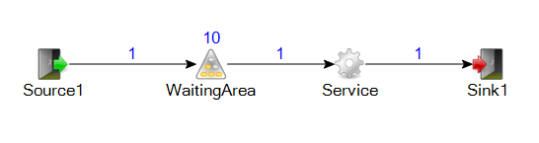
5. Discrete Event Simulation

Slide 45
5. Discrete Event Simulation
Customers appear discretely with a randomized time interval
The waiting area can hold 10 people
There is only 1 hair dresser
The hair cutting process is somewhat normally distributed
Mean = 600seconds
S.D = 100 seconds
Minimum (breach of normal) = 200 seconds

Slide 46
5. Discrete Event Simulation
We can experiment with the settings of the model
We can vary the structure (number of hair dressers)
We can change the expected time interval of work and arrival
We can make the waiting area bigger
We can make the model more complex
How long before a customer gets bored?
We can automate experiments run on a model varying parameters
and then look at solutions with attractive properties.

Slide 47
5. Discrete Event Simulation
We can validate some parameters of the model through real world investigation
What are the properties of the probability distributions?
This is the basis of the FACTS system developed here at Skövde

Slide 48
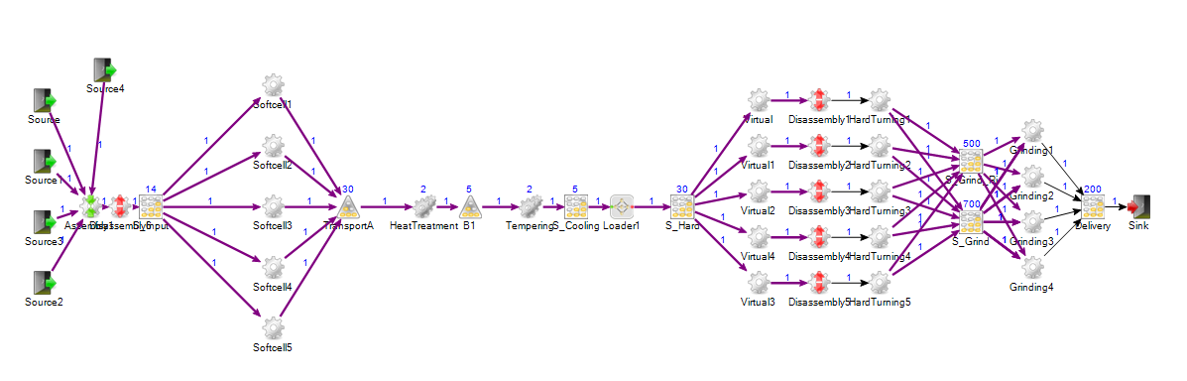
5. Discrete Event Simulation
A more complex real world model (part of a production line of a partner company)

